Slide 1
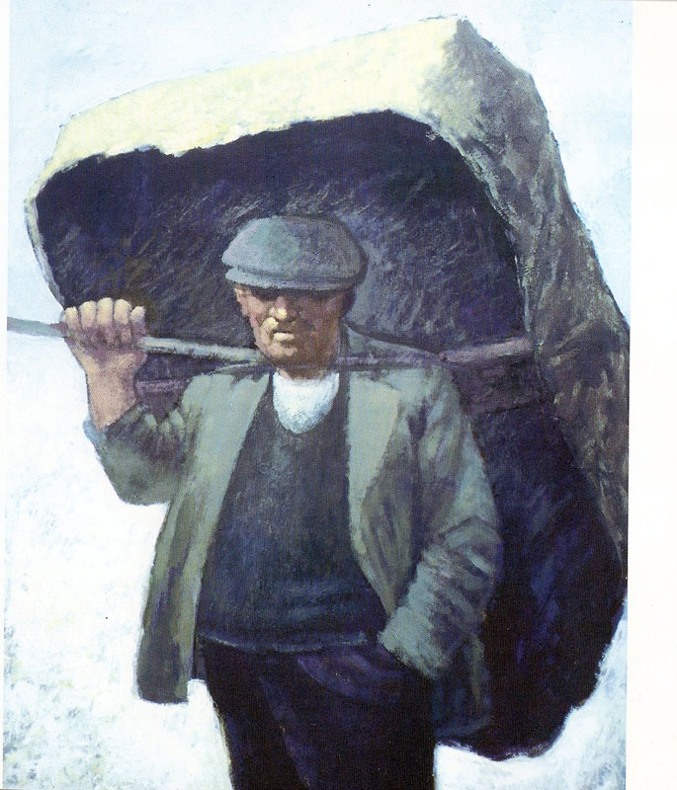
Used with kind permission of Aneurin Jones
A series of interactive lessons and instructions for teachers to create a art project:
Years 5 a 6
Lesson 10
Workers and the workhouse during Victorian Times
Next page
Notes:
1

Slide 2
Close observation of an
artists work.
Task:
Look closely at a picture created by the Welsh artist Aneurin Jones and note what images, tones and lines can be seen in the piece.
Previous page
Next page

Slide 3
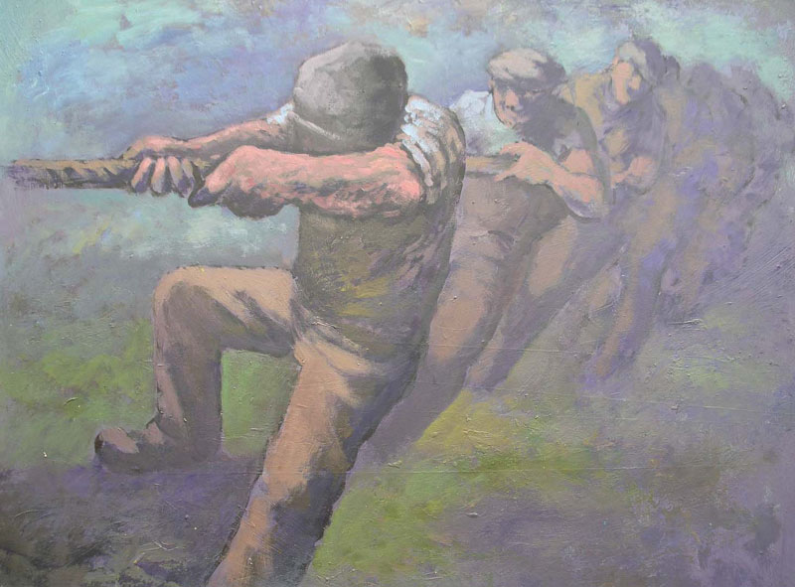
Used with kind permission of Aneurin Jones
Investigating Picture Features
What lines can be seen in the picture?
Record your answers in the box below.
‘Tug o’ war’ by Aneurin Jones
Can you copy the tones that can be seen in the picture? Record the tones in the boxes below.
What images in the picture give us an idea of the time? Record your ideas in the box below.
Previous page

